Slide 1
What is being transferred in transfer learning？
报告人：罗宏涛 2020.11.17

Slide 2
What is being transferred in transfer learning？
Motivation
*Experiments
Conclusion

Slide 3
Motivation

Slide 4
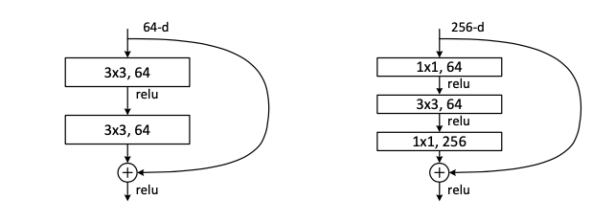
AlexNet
ResNet
Krizhevsky et al.—NIPS 2012
Kaiming He et al.—2016 CVPR

Slide 5


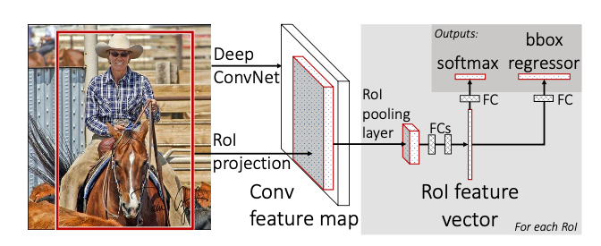
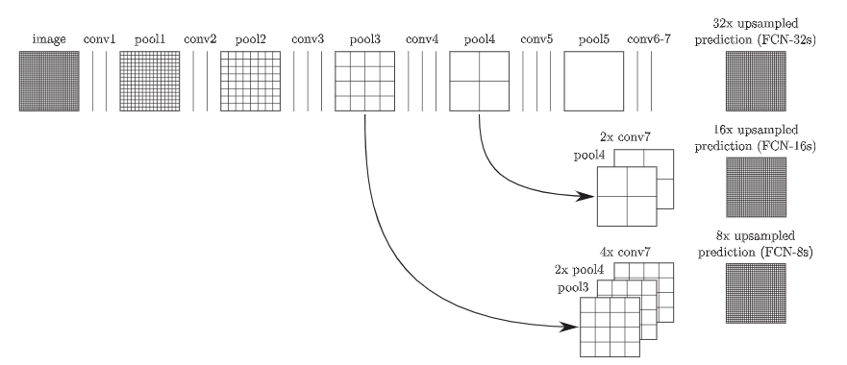
Faster r-cnn
R. Girshick et al. arXiv 2015
FCN
Evan Shelhamer et al. IEEE 2017
Kaiming He et al. ResNet

Slide 6
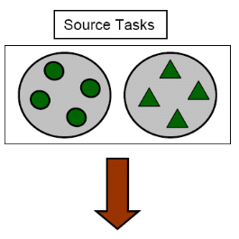
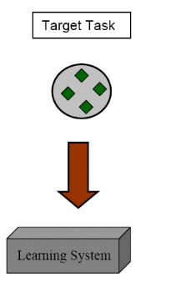

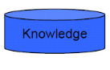
What enable a successful transfer?
Which part of the network is responsible for that?
? ?

Slide 7
Experiments

Slide 8
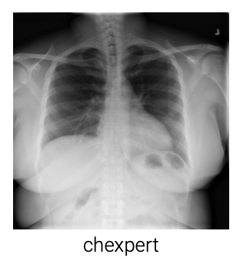



Target Domain
CheXpert
DomainNet-real
DomainNet-clipart
DomainNet-quickdraw

Slide 9
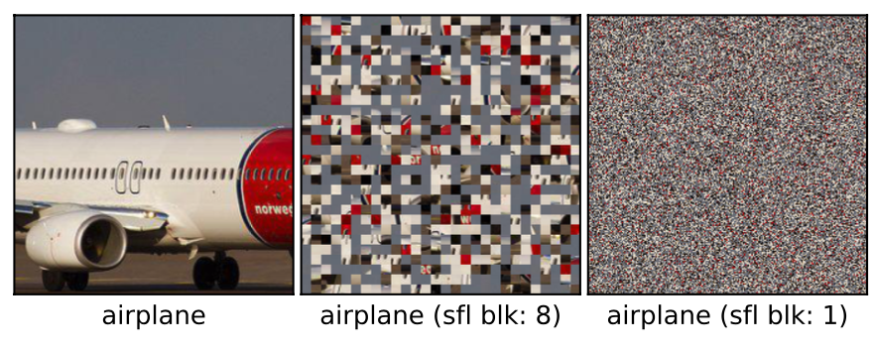
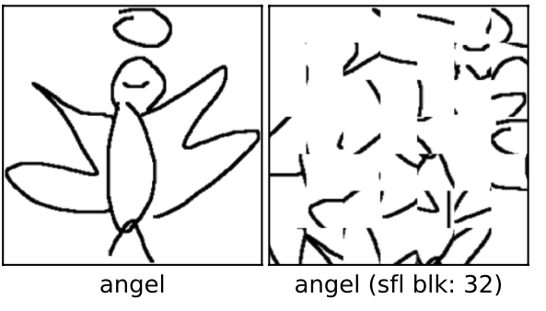
Target Domain

Slide 10
Notation
T：Trained
P：Pre-trained (ImageNet)
RI：Random Initialization
P-T：Model fine-tuned on target domain starting from pre-trained weights
RI-T：Model trained on target domain from random initialization

Slide 11
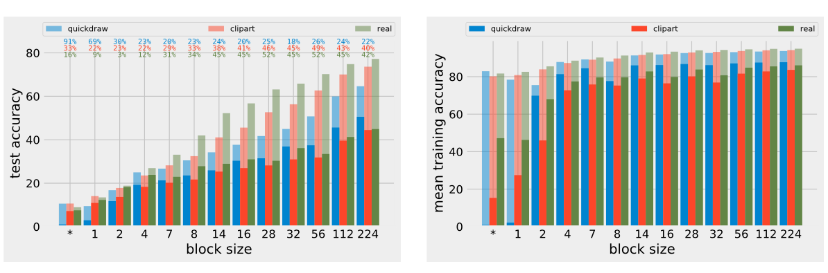
Role of feature re-use
Largest performance boost on the real domain
P-T converges much faster than RI-T in all cases
Final performance drops for both RI-T and P-T as the block size decreases
On quickdraw, the accuracy difference does not show a decreasing pattern as in the other two domains
The optimization speed on P-T is relatively stable

Slide 12
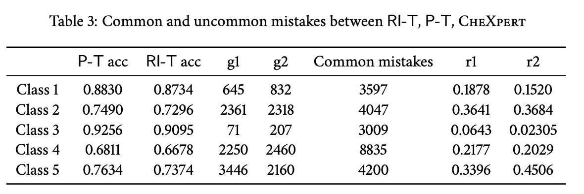
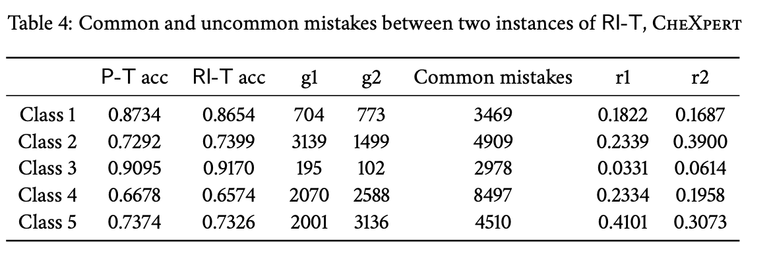
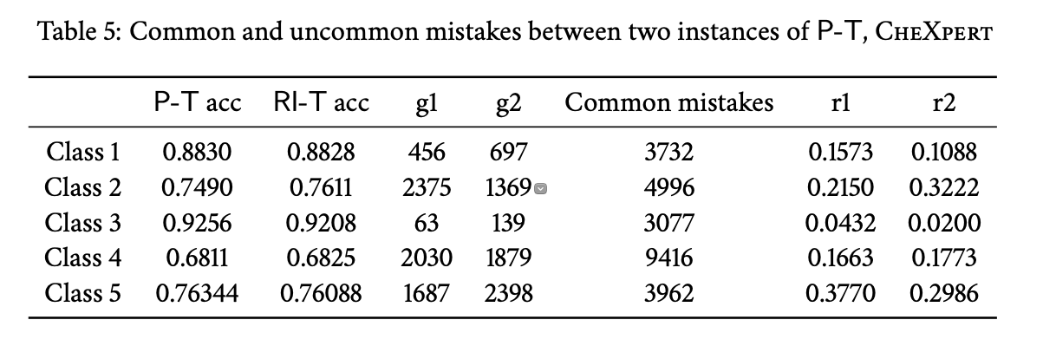
Investigating mistakes
Note a considerable number of uncommon mistakes between P-T and RI-T models while two P-Ts have strictly fewer uncommon mistakes
P-T model is incorrect include ambiguous examples while RI-T model is correct
P-T model is correct include easy examples while RI-T model is incorrect
The mistaken examples between two instances of P-T are very similar

Slide 13
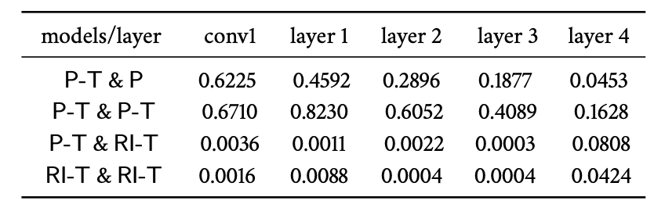
Feature Similarity
Feature similarity(use CFK) for different layers of ResNet-50, target domain CheXpert
Two instances of P-T are highly similar across different layers
The initialization point drastically impacts feature similarity
Although both networks are showing high accuracy, they are not that similar in the feature space
Two P-T are re-using the same features
Similarity of neural network representations revisited. S. Kornblith et al. ICML19

Slide 14
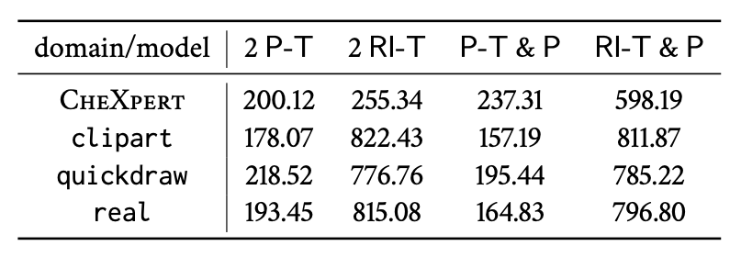
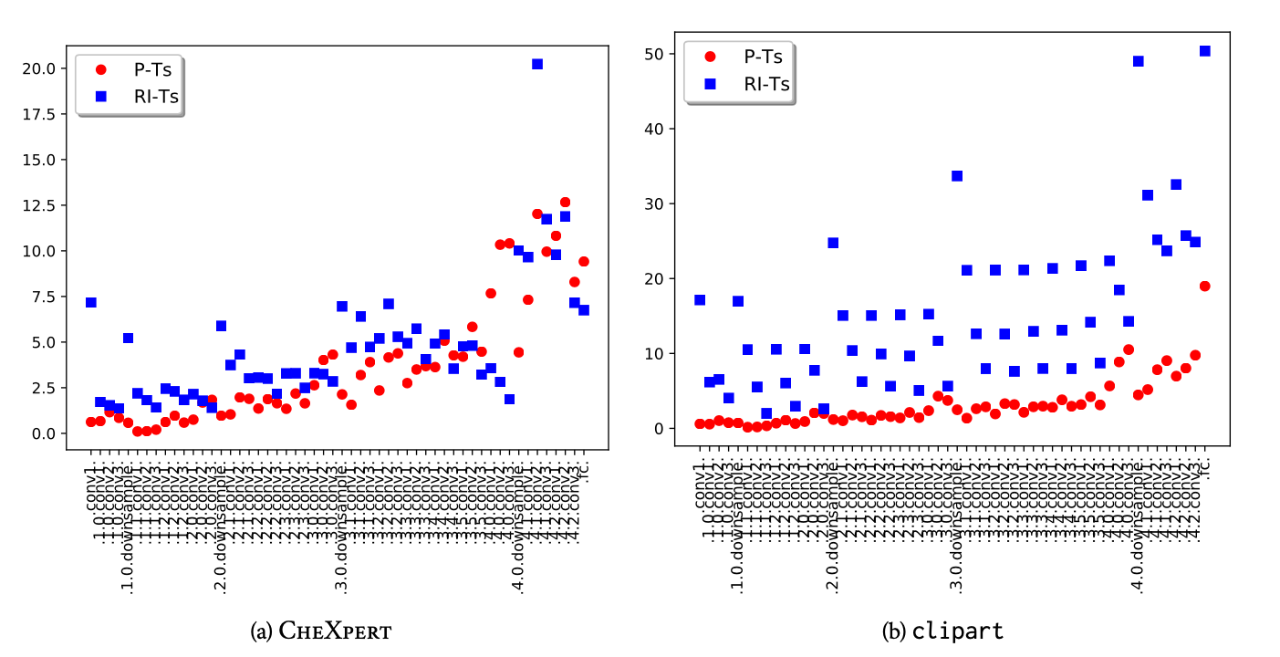
Distance in parameter space
RI-Ts are farther from each other compared to two P-Ts
The first trend can be seen in individual modules too
The distance between modules increase as we move towards higher layers in the network
Features L2 distance for different target domains
Feature L2 distance per module

Slide 15
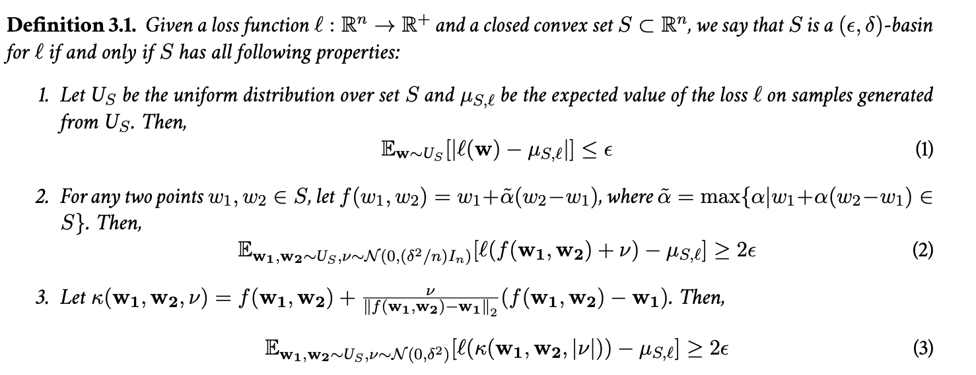
Performance barriers and basins in the loss landscape
For most points on the basin, their loss should be close to the expected value of the loss in the basin (1)
By adding Gaussian noise to the points in the basin, the loss should be increase (2)
By extrapolating two points on the basin, the loss should increase (3)

Slide 16
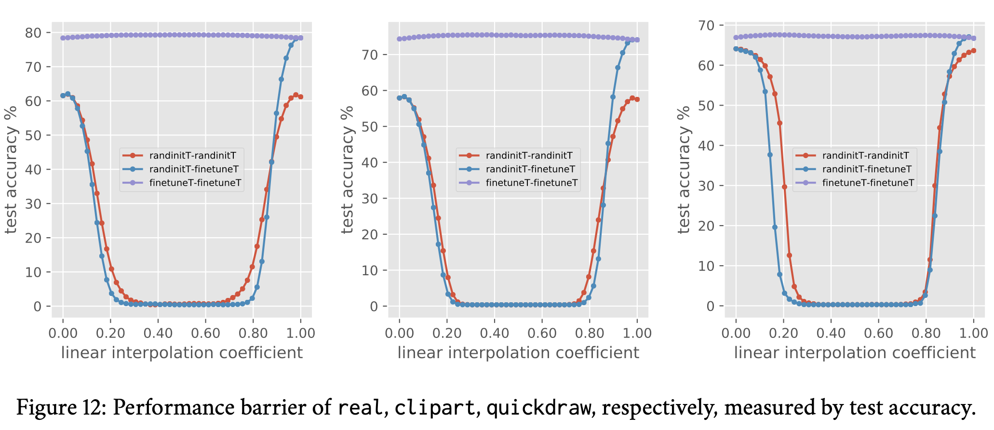
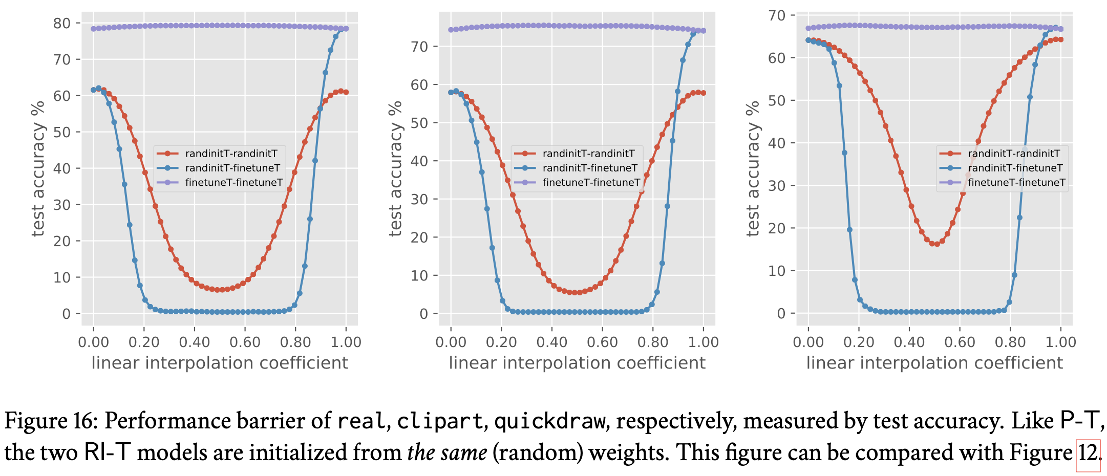
Performance barriers experiments with identical initialization for RI-T

Slide 17
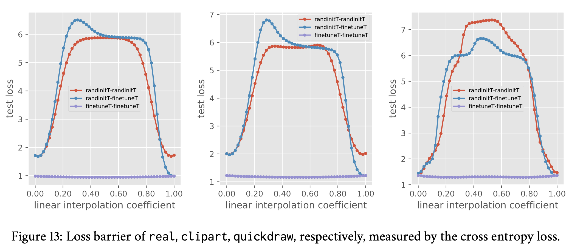
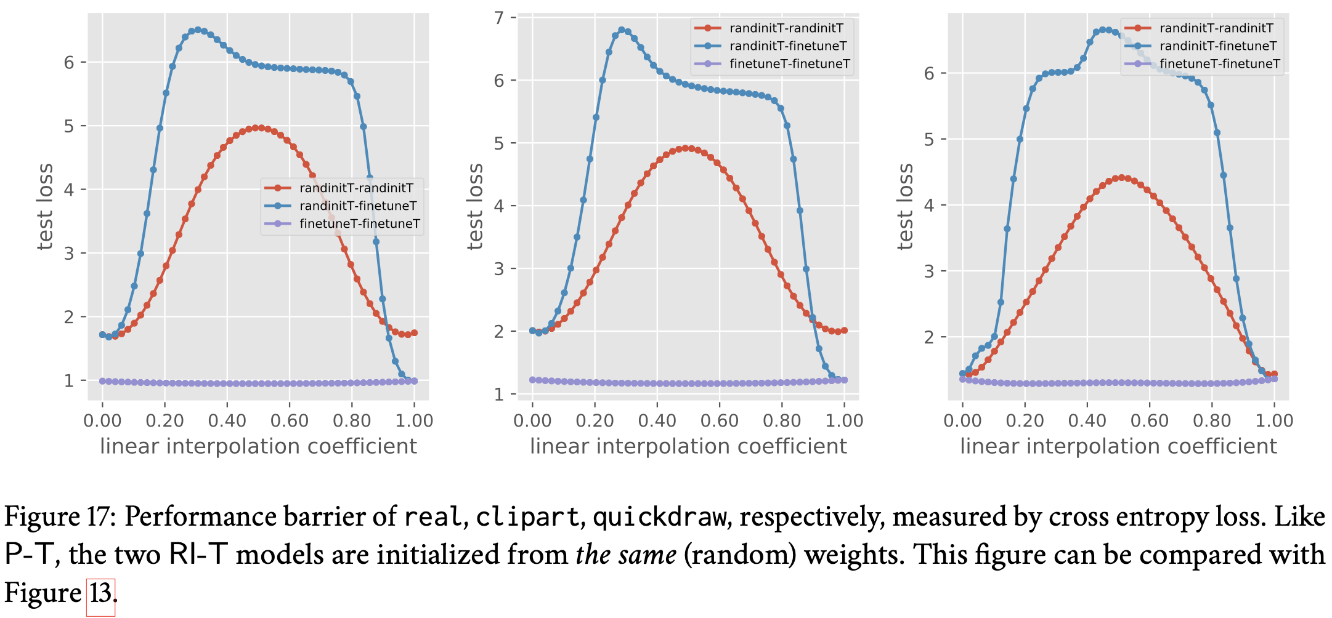
Performance barriers experiments with identical initialization for RI-T
Barriers between two RI-T models become slightly smaller when the initial weights are the same.
Significant barriers still exist when comparing with the interpolation between two P-T models.

Slide 18
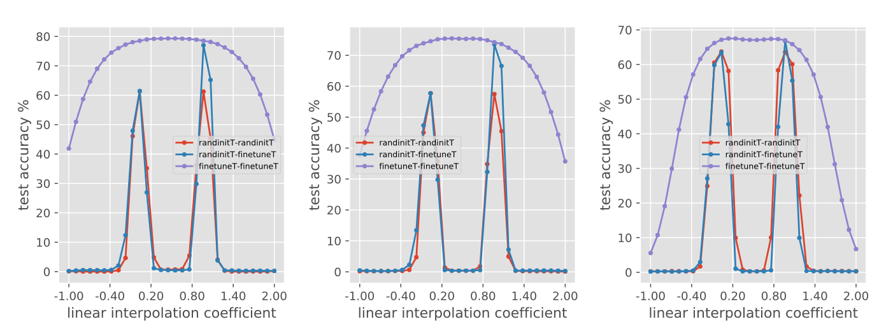
Performance barriers plots with extrapolation
Performance barrier of real, clipart, quickdraw, respectively, measured by test accuracy.
The linear combination of weights are extrapolated beyond [0, 1] (to [−1, 2])

Slide 19
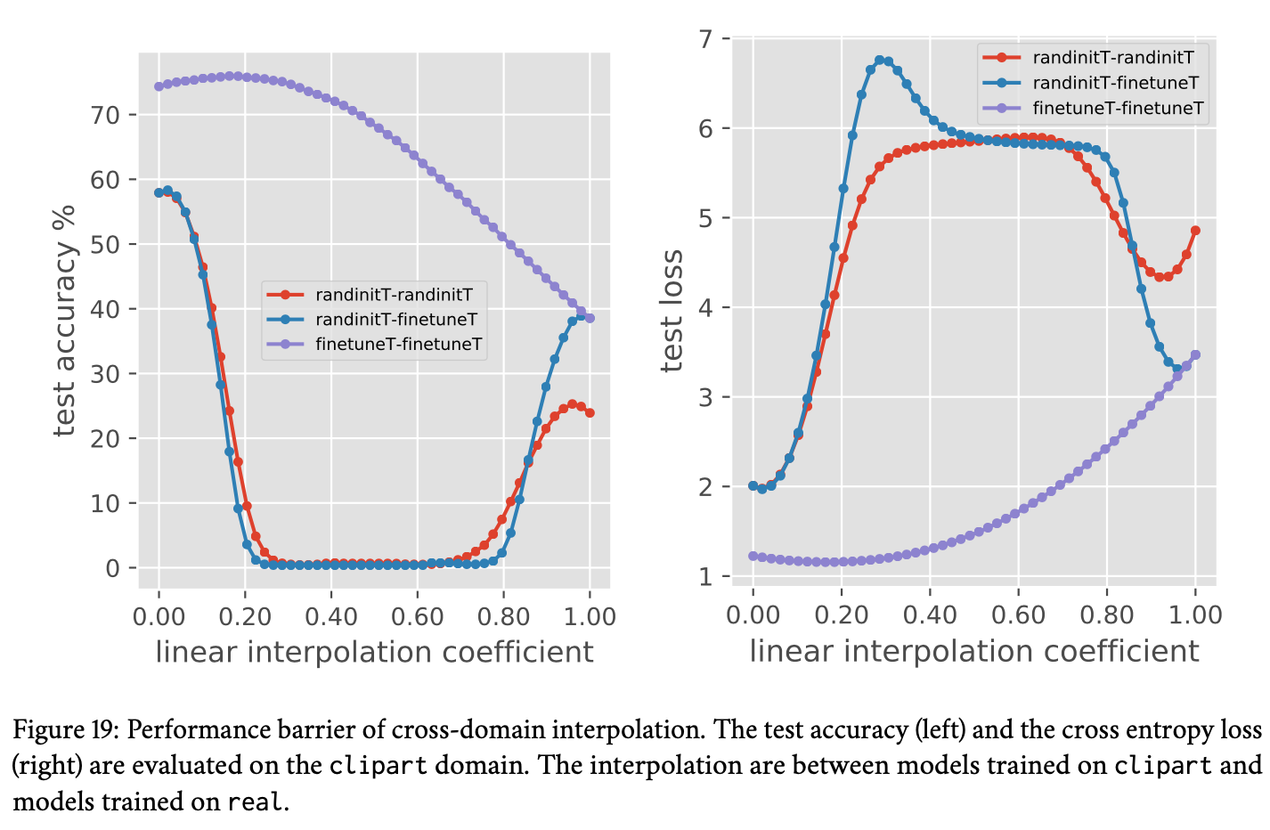
Cross-domain weight interpolation on DomainNet
P-T consistently outperforms RI-T even in the cross-domain cases
When interpolating between P-T models, we observe performance boost in the middle of the interpolation
All the trained P-T models on all domains are in one shared basin

Slide 20
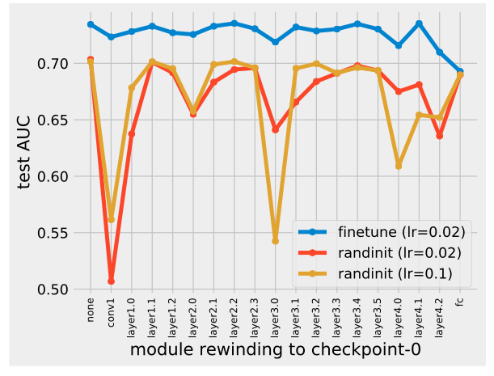
Module criticality in transfer learning
Consider a trained network, take one of the modules and rewind its value back to its initial value while keeping the weight value of all other modules fixed at trained values.
Critical：the performance of the model drops significantly after rewinding.
Are all layers created equal? Zhang et al.

Slide 21
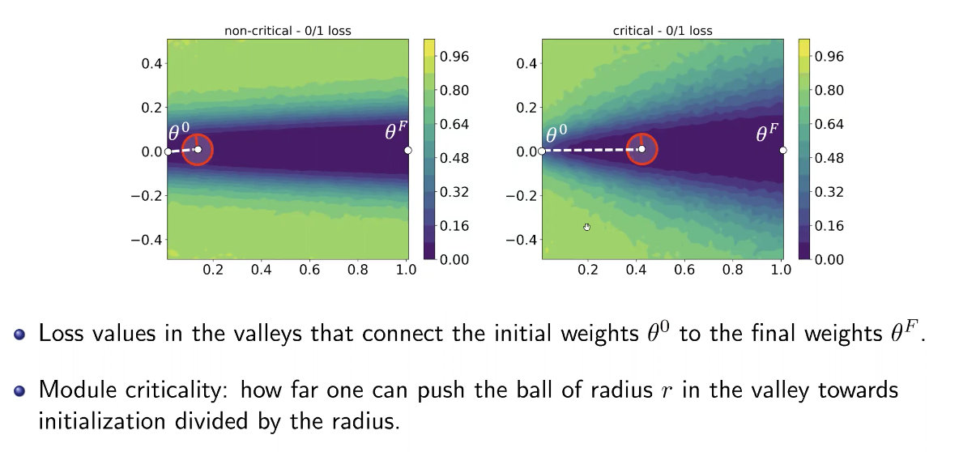
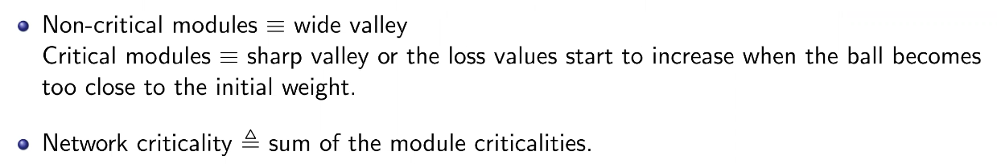
Module criticality

Slide 22
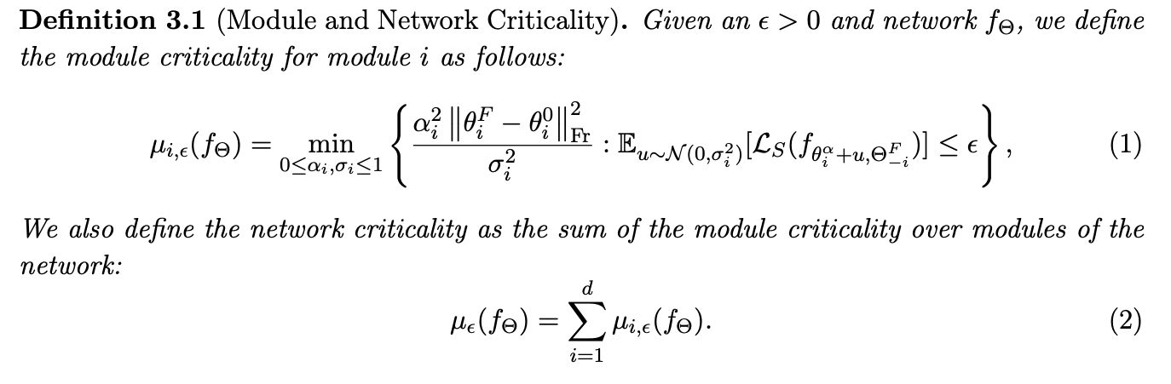
Module Criticality Definition

Slide 23
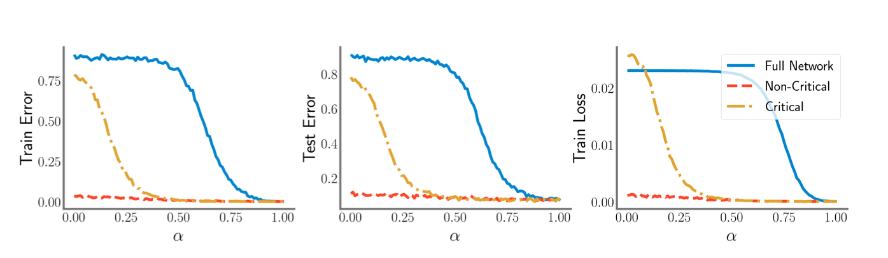
Plots for a critical and non-critical module
The blue (solid) curve is when we replace all the parameters in the network by the convex combination between their initial and final value simultaneously.
The red (dashed) curve corresponds to moving on the convex path for a single (non-critical) layer.
The yellow (dashdot) curve corresponds to moving on the convex path for a critical layer in ResNet-18 architecture.

Slide 24
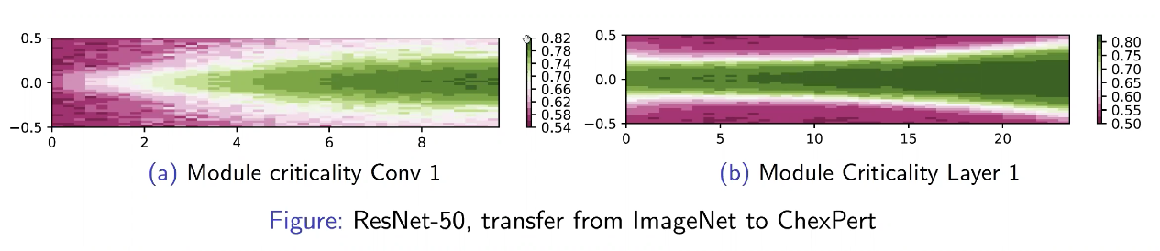
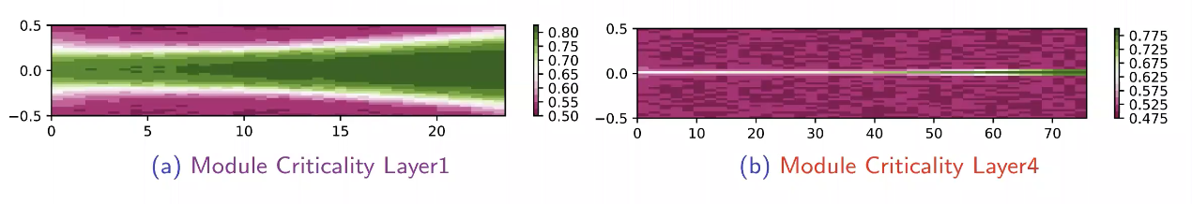
Plots for a critical and non-critical module
As we move from the input towards the output, we see tighter valleys, I.e., modules become more critical
Lower layers are in charge of more general features while higher layers are more specialized for the target domain

Slide 25
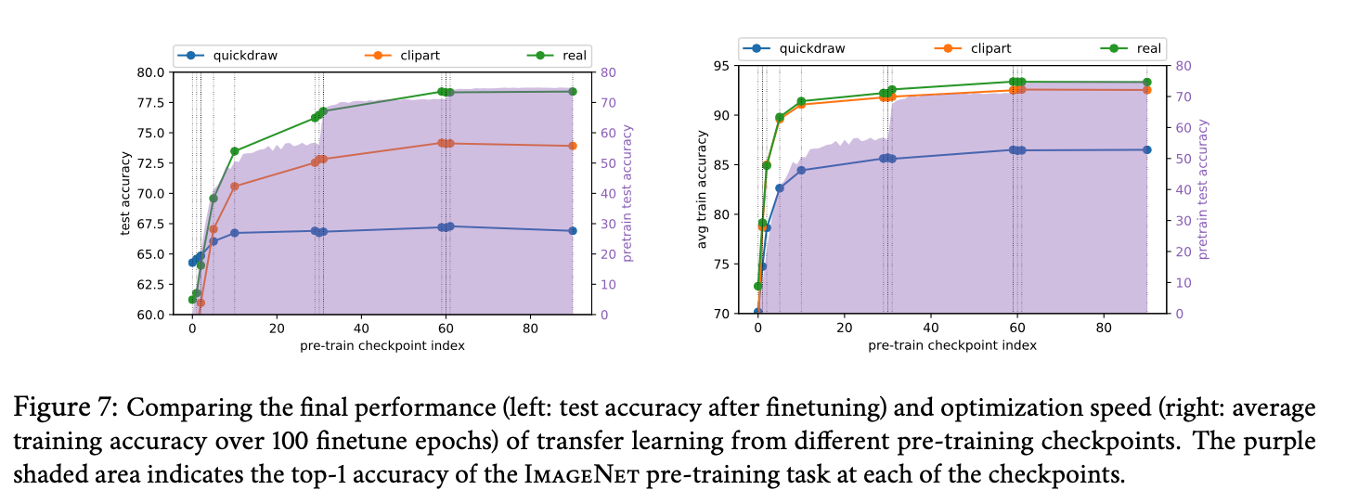
Which pre-trained checkpoint is most useful for transfer learning?
Significant improvements are observed when we start from the checkpoints where the pre-training performance has been plateauing(i.e. checkpoint 29 and 59)
Earlier checkpoints in pre-training are out of basin of the converged model and at some point during training we enter the basin. This also explains the plateau of performance after some checkpoints. Therefore, we can start from earlier checkpoints in pre-training.

Slide 26
Conclusion

Slide 27
Conclusion
Models trained from pre-trained weights：
Stay in the same basin of the solution
Have similar features and models are close in L2 distance in parameter space
Lower layers are in charge of more general features
We can start from earlier checkpoints of pre-trained model as long as the pre-trained model enters its final basin (improve ensemble method)

Slide 28
Thanks

